Slide 1
Research Question – Tutorial Presentation for Feedback Date:
Group Name: 2020 US General Election Turnout Rates Name of Student Presenting:

Slide 2
7COM1079-2024 Student Group No: A 231 Names of Student Attendees : Chandrakanth Pugalenthi
Gurucharan Kataru
Hanuman Shabarish Siddam Setty
Praveenraj Gopalakrishnan
Sathyanarayana Mora
Dataset ID: DS185
It is a dataset for studying the variables that determine political participation and engagement in every state, as represented by the recorded voter turnout in the 2020 general elections across the United States.
Our Independent variable is: State,(nominal/categorical). Our Dependent variable is: Voter turnout rate(interval/continuous).

Slide 3
”Is there a difference in the mean voter turnout rate (dependent interval variable) between states independent nominal variable)?”
Our Research Question is:

Slide 4
1. Null hypothesis (Ho): The average rate of voter turnout is not much different in every state. 2. Alternative hypothesis (H1): States' average of voter turnout rate is not all the same from each other.
Hypothesis

Slide 5
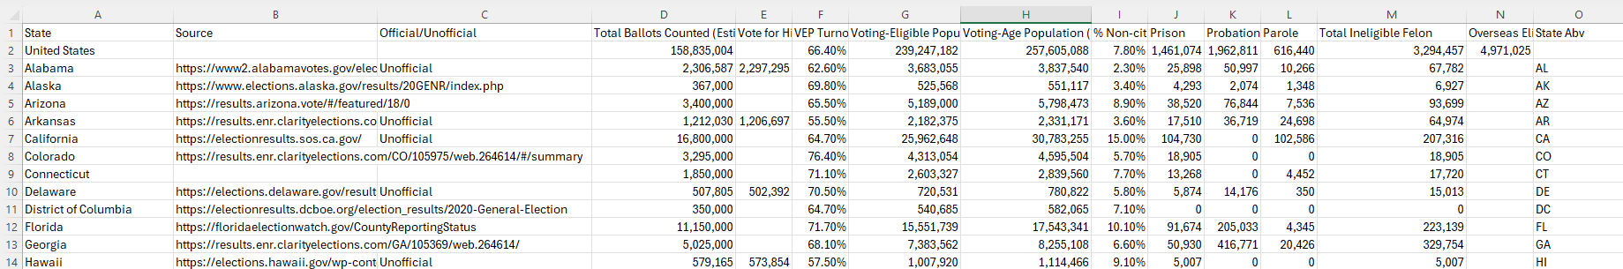
There are 53 rows and 15 columns.

Slide 6
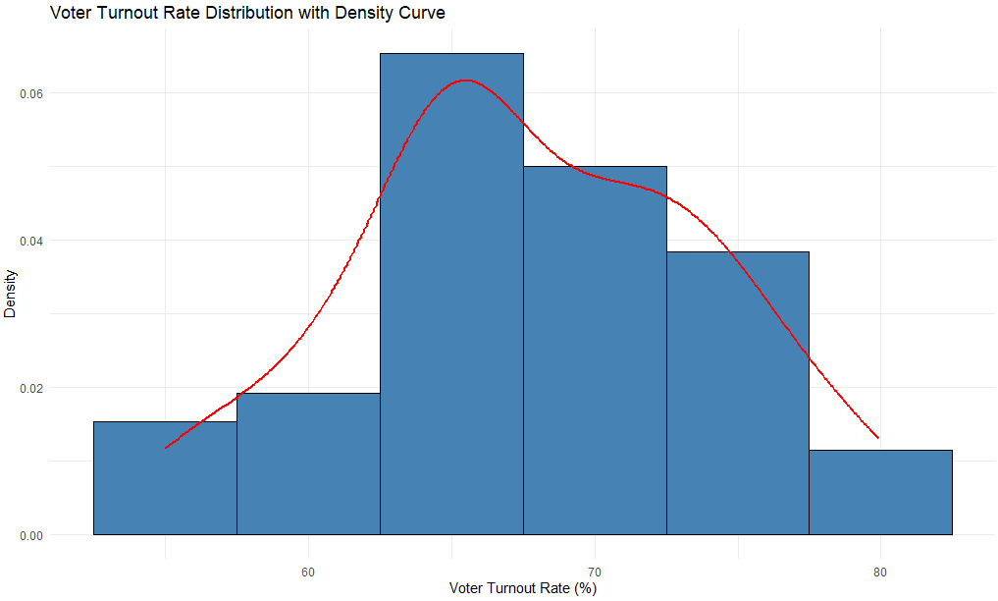
Visualization
The histogram states that the data is not normally distributed (positively Skewed).

Slide 7
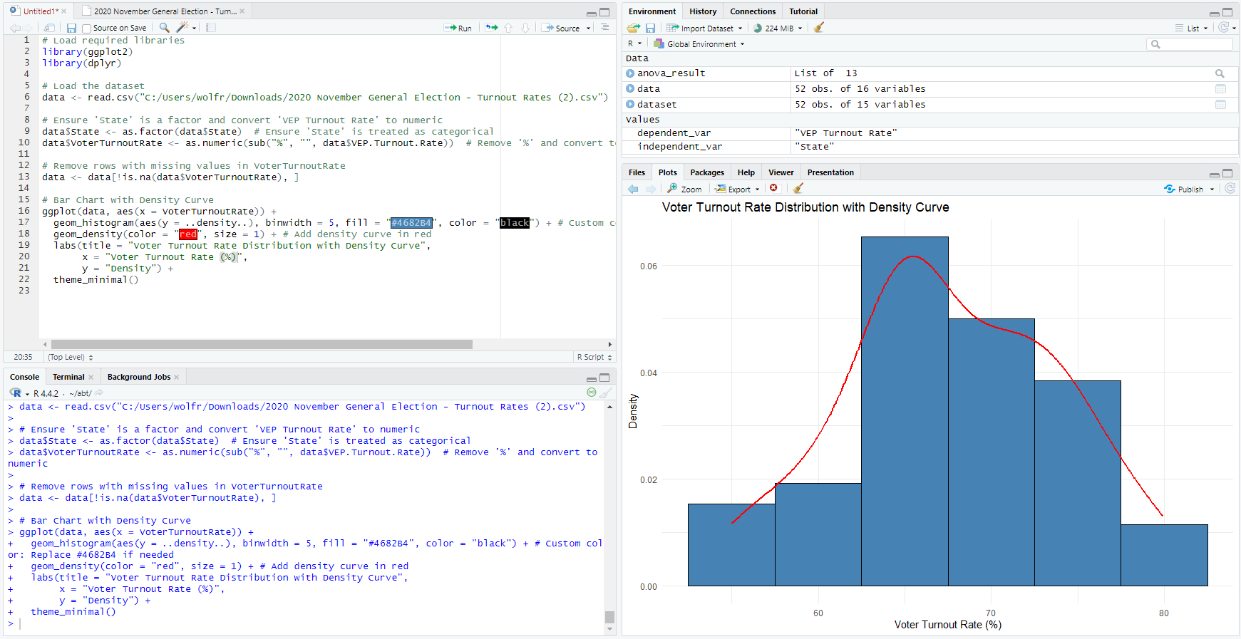
Code Snippet

